Slide 1
Interoperability and Information Sharing Foundational Elements for Transformation of Care
Janet M. Marchibroda
Director, health innovation initiative
Executive director, Ceo Council on health and innovation
Bipartisan policy center
October 7, 2014

Slide 2
Established in 2007 by former Senate Majority Leaders Howard Baker, Tom Daschle, Bob Dole and George Mitchell
The only Washington, D.C.-based think tank that actively promotes bipartisanship
Works to address the key challenges facing the nation, including those related to economic policy, energy, housing, immigration, and health care.
BPC combines politically balanced policymaking with strong, proactive advocacy and outreach.
See www.bipartisanpolicy.org

Slide 3
Why Interoperability and Electronic Information Sharing Matter…. High-Level View of BPC’s Work in This Area

Slide 4
BPC Task Force on Delivery System Reform and Health IT
Led by BPC Health Project Co-Chairs and former Senate Majority Leaders Tom Daschle (D-SD) and Bill Frist (R-TN) and comprised of leaders across every sector of health care
Informed by research and interviews with 40 high-performing organizations
Focus of Task Force and Report:
What are the common attributes of high performing organizations and new models of care?
What are the information needs and capabilities of these new models of care?
How do current health IT investments align with those information needs and capabilities?
What actions are needed to close the gaps?
Link: http://bipartisanpolicy.org/sites/default/files/Transforming%20Health%20Care.pdf

Slide 5
Attributes of High Performance | Role of Health IT
Organizational and clinical leadership | Aggregates and analyzes clinical, administrative, community, and patient-generated data through analytics to set goals, monitor progress, and improve performance
Informed clinicians and care teams at the point of care and in between visits | Provides ready access to clinical decision support tools and information about the patient, to inform clinical decision-making at the point of care and between visits, through the use of EHRs and health information exchange
Coordinated care delivery across settings | Enables electronic access for all members of the care team to information about the patient—from across the multiple settings in which care and services are delivered—through electronic information sharing or health information exchange

Slide 6
Attributes of High Performance | Role of Health IT
Engagement of individuals in their health and health care; focus on prevention and wellness | Provides patients access to information contained in their EHRs Educates, engages, and supports individuals through the use of online, electronic, and mobile consumer e-health tools
Providing timely access to care | Enable “virtual” visits or online consultations, secure email communications between clinicians and patients, and online health care transactions, through consumer e-health tools
Alignment of payment incentives with quality, cost, and patient experience outcomes | Aggregates and analyzes clinical, administrative, and patient-generated data through analytics to: Measure outcomes in cost, quality, and patient experience of care Identify gaps and duplications in care to inform clinical decision-making Identify and predict areas requiring intervention and improvement

Slide 7
Collaborative effort of:
American College of Physicians
Association of Medical Directors of Information Systems
American College of Surgeons
American Academy of Pediatrics
American Society of Clinical Oncology
Doctors Helping Doctors Transform Health Care
Bipartisan Policy Center
Purpose
Gain an understanding of clinician needs for access to electronic health information to support transitions in care
When a patient under your care is discharged from a hospital
When a patient is referred to you
When you get information back from a consulting clinician
Link http://bipartisanpolicy.org/sites/default/files/Clinician%20Survery_format%20%282%29.pdf

Slide 8
A majority of clinicians believe that electronic exchange of information will have a positive impact on health care
Lack of interoperability and an exchange infrastructure, and the cost of both, are major barriers to electronic information sharing
Common recognition of high priority data types needed for transitions of care across specialties
“Push” and “pull” (or query) exchange methods are needed
Timeliness and integration into work flow is needed

Slide 9
Health Affairs Health Policy Brief Interoperability: To achieve EHRs’ full potential, providers must be able to exchange information easily, accurately, and securely

Slide 10
What’s the Issue?

Slide 11
Electronic information sharing plays a critical role in:
Improving the cost, quality, and patient experience of care
Rapidly emerging delivery system and payment models
Transparency initiatives
$27 billion in health IT investments under HITECH
$25 billion in Medicare and Medicaid EHR incentives¹
408,353 EPs
4,637 hospitals
% adoption of at least a basic EHR in 2013
48% of physicians²
50% of hospitals³
1 http://www.cms.gov/Regulations-and-Guidance/Legislation/EHRIncentivePrograms/Downloads/August2014_SummaryReport.pdf
2 Hsiao C.J., Hing, E. (2014). Use and Characteristics of Electronic Health Record Systems Among Office-based Physician
Practices: United States, 2001–2013. NCHS Data Brief, no 143.
3 Adler-Milstein, J., DesRoches, C.M. et al. (2014). More Than Half of US Hospitals Have at Least a Basic EHR, But Stage 2
Criteria Remain Challenging for Most. Health Affairs, 33, no. 9 (2014): 164-1671

Slide 12
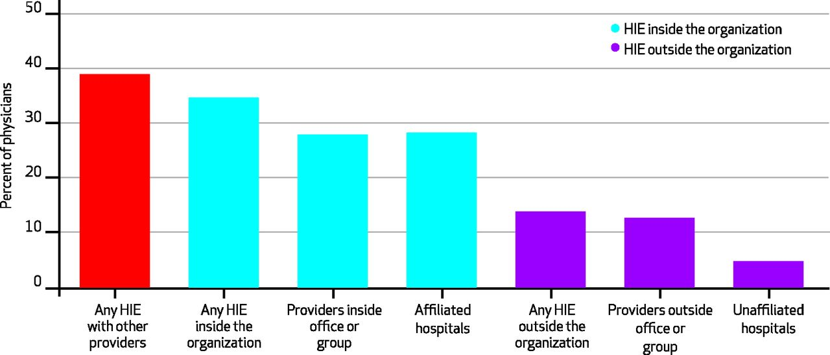
Furukawa M F et al. Health Aff doi:10.1377/hlthaff.2014.0445

Slide 13
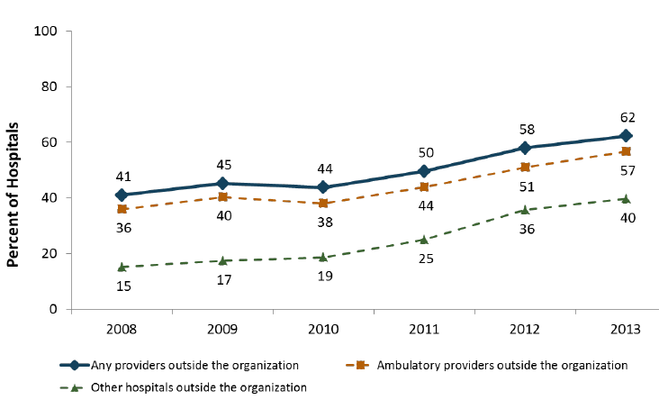
Percentage of hospitals that have electronically exchanged either lab results,
radiology reports, clinical care summaries or medication lists with outside providers
Furukawa, M.F. et al. Health Affairs, 32, no. 8 (2013): 1246-1354

Slide 14
In order to achieve electronic information sharing:
EHRs and other clinical software must be “interoperable” or have the capability to exchange information using agreed-upon standards, and
Those providing care and services must be willing to share information.

Slide 15
Lack of a business case: predominant method of payment rewards volume over outcomes
Lack of access to or cost of infrastructure to support exchange
Lack of standards adoption and interoperability of systems
Some concerns about privacy
Some concerns about liability

Slide 16
What’s in the Law?

Slide 17
Stage 1 Requirements | Stage 2 Requirements
Hospitals and eligible professionals (EPs) are required to provide a summary of care record for more than 50 percent of transitions of care or referrals (which need not be transmitted electronically) | Hospitals and EPs are required to provide a summary of care record for more than 50 percent of transitions of care or referrals (which need not be transmitted electronically)
 | Hospitals and EPs are required to electronically transmit a summary of care record for more than 10 percent of transitions of care and referrals.
 | Hospitals and EPs must also send at least one summary of care record electronically to a recipient that uses a different EHR vendor or a CMS-designated test EHR
Summary of care document has no required elements | Summary of care document must include the following: Current problem list Current medication list Current medication allergy list

Slide 18
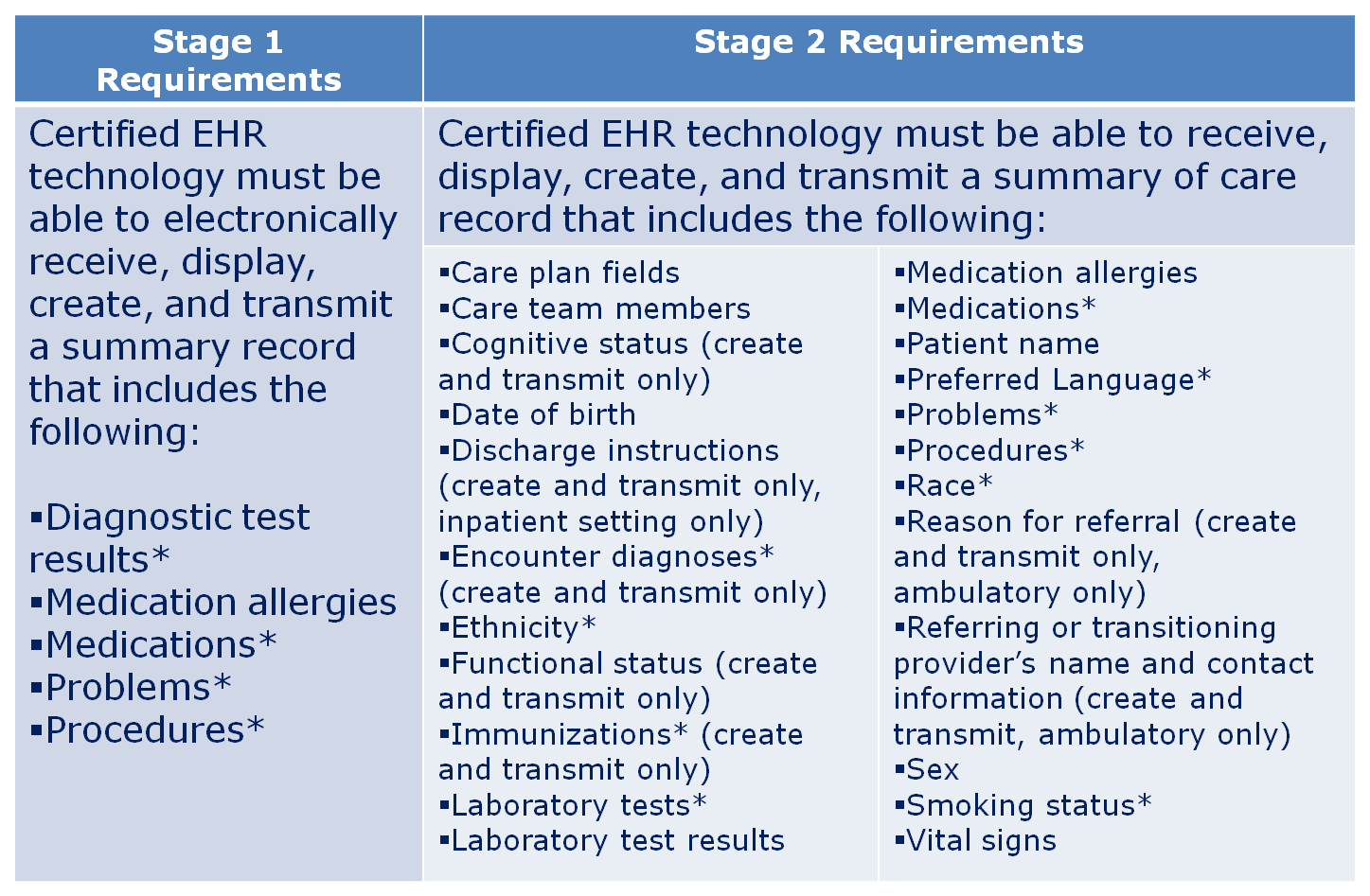

Slide 19
Recent Recommendations

Slide 20
ONC Ten-Year Vision
Principles:
Build upon existing health IT infrastructure
One size does not fit all
Empower individuals
Leverage the market
Simplify
Maintain modularity
Consider environment
Focus on value
Protect privacy and security
10 Year Plan
3 Years: Send, receive, find, and use health information to improve health care quality
6 Years: Use information to improve health care quality and lower cost
10 Years: Learning health system

Slide 21
April 2014: JASON Report
Overarching software architecture for a health data infrastructure
Requirements for EHR software vendors to develop, publish, certify APIs to facilitate exchange
May 2014: PCAST Report
Reiterated 2010 PCAST recommendations
Creation of health information infrastructure
Development of universal exchange language that enables data to be shared

Slide 22
February 2014 bipartisan, bicameral, tri-committee SGR legislation
Establishes a date certain by which there should be “widespread exchange of health information through interoperable certified EHR technology nationwide”
Requires actions, which could include adjustments in incentive payments and criteria for decertifying EHR technology products, if such goals are not achieved
Contains provisions to prevent the blocking of information sharing, requiring providers to attest that they have not knowingly and willfully taken any action to limit or restrict the compatibility or interoperability of certified EHR technology
July 2014 Senate Appropriations Committee report accompanying the Labor-HHS 2015 spending bill
Contains provisions designed to discourage information blocking by decertifying EHR products
Requires reporting of EHR companies and providers who engage in information blocking
Requires submission of report on challenges and barriers to interoperability

Slide 23
Inclusion of special terms and conditions in CMMI demonstration programs associated with delivery system and payment reforms that would require electronic information sharing to support coordination and management of services and to monitor the quality of care.
Leveraging state use of the Federal Medical Assistance Percentages (FMAP) at the 90/10 matching level to support health information exchange activities.*
Addition of new requirements within CMS Conditions of Participation or Coverage for a wide range of health care organizations, to ensure timely electronic exchange of information to support patient admissions, discharge, and transfers as well as care planning to ensure continuity of care across inpatient, post-acute, and long-term care settings.
Inclusion of requirements for ACOs under the Medicare Shared Savings Program.
Inclusion of requirements for those participating in CMMI pilot programs, including the Bundled Payments for Care Improvement Initiative, Comprehensive Primary Care Initiative, the Pioneer ACO model, and the State Innovation Model Initiative.
Inclusion of new measures in the Consumer Assessment of Healthcare Providers and Systems (CAHPS) survey to encourage improved beneficiary access to their personal health information.
*Only one implemented

Slide 24
Where Do We Go From Here?

Slide 25
Absent any action…we will simply continue with the status quo
Actions fall into three primary categories
Legislative
Executive Branch
Private Sector-Driven
One thing we know for sure
We will not get to truly a higher quality, more cost-effective, patient-centered health care system until we solve this problem

Slide 26
Thank You! Janet Marchibroda Bipartisan Policy Center 1225 Eye Street, N.W., Suite 1000 Washington, D.C. 20005 202.379.1634 jmarchibroda@bipartisanpolicy.org

